Slide 1
Vice-President
Finance & Administration
Divisional Management
Meeting
Gary Brewer
February 24, 2017

Slide 2
Outline
Budget Planning Update
Capital Planning Updates
    Under construction
    Future capital projects
    Major renovations
Cap and Trade Report
Community Safety
  Sexual Violence Policy Development Update
Questions and Answers

Slide 3
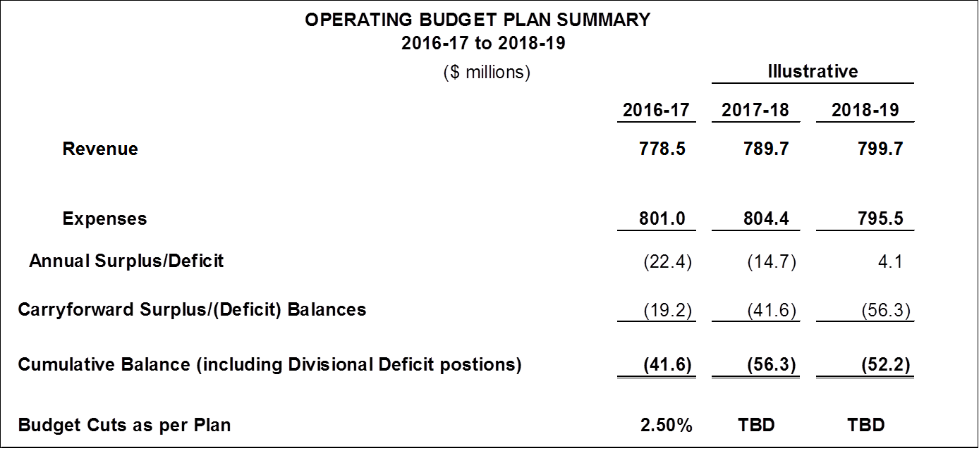
Budget Plan 2016-19
(Including Projected Divisional Deficits)

Slide 4
Capital Market Performance
(Endowment and Pension Fund)
Endowment Performance to December 2016
 |  |  | Fiscal YTD 8 months December |  |  | Calendar YTD 12 months ended December
 | Endowment Fund Rate of Return |  | 10.12% |  |  | 7.74%
 | Policy Benchmark |  | 12.15% |  |  | 9.19%
 | Value Added |  | -2.03% |  |  | -1.45%
Pension Fund Performance Calendar Year 2016
Total Fund (net return) |  | 7.60%
Benmark |  | 4.30%
Value Added |  | 3.30%

Slide 5
Divisional Year End Projections 2016-17

Slide 6
Update on Key Planning Assumptions
Enrolment Update

Slide 7
Strategic Enrolment Management Successes 2016-17
2nd year of brand campaign with focus on career outcomes
Strengthened Digital Campaign
Changed Approach to Offer Programs of Choice
Issued Early Offers to Capture Program Interest
Innovative Program Changes
Delivered First-Year Transition Programs
Outcomes
Improvements in:
Confirmation Rates
Conversions
Course Loads
Retention

Slide 8
Enrolment Update 2016-17
Undergraduate FFTE Projections
 | 2012-13 Actual | 2013-14 Actual | 2014-15 Actual | 2015-16 Actual | 2016-17 Enrolment Contract Target | 2016-17 University Budget Target ¹ | 2016-17 Prelim. Actuals²
Eligible | 40,631.8 | 39,713.7 | 38,095.8 | 36,789.1 | 37,031.3 | 36,250.1 | 36,614.4
Visa | 3,211.7 | 3,569.9 | 3,994.2 | 4,449.6 | 4788.4 | 4,548.8 | 5,057.1
Other Ineligible³ | 263.2 | 259.0 | 261.6 | 248.9 | 261.6 | 259.0 | 274.7
Total | 44,106.7 | 43,542.6 | 42,351.6 | 41,487.6 | 42,081.3 | 41,057.9 | 41,946.3
1. University Budget Target includes projected Engineering growth over 2011-2012
2. Includes summer and fall actuals and winter estimates as of Feb 6, 2017
3. BDesign FFTEs only, excludes on-site exchange students.
Notes:
Enrolment Contract Target aligns with SMA commitments
Faculties experiencing domestic declines and/or short of enrolment contracts: LAPS, ENVS, Glendon and Science
Target and actuals includes the government-mandated decrease in enrolment in Education to conform to the new 2-year curriculum. Education enrolment tracking up-to plan.
Eligible includes international eligible students.
Other ineligibles include ineligible programs (e.g. York/Sheridan Design). Inbound exchange students not included.
Other ineligibles did not have a target. The “target” is set to last years actuals.

Slide 9
2016-17 Masters Fall FTEs
 | Nov 2007 Actual | Nov 2013 Actual | Nov 2014 Actual | Nov 2015 Actual | Nov 2016 Enrolment Contract Target | 2014/15 to 2016/17 Ministry Target ¹ | Nov 2016 Actual
Eligible | 2,587.7 | 2,320.5 | 2,280.4 | 2,269.3 | 2,391.7 | 2,589.4 | 2,262.7
Visa | 160.3 | 414.6 | 559.3 | 561.2 | 561.2 | N/A | 591.5
Other Ineligible | 119.6 | 148.0 | 148.4 | 141.3 | 141.3 | N/A | 130.0
Total | 2,867.6 | 2,883.1 | 2,988.1 | 2,971.8 | 3,094.2 | N/A | 2,937.2
1. Targets as provided in SMA, April 16, 2014. Government reduced the target from the previous target by 159.58 FTEs from 2,748.98 FTEs
Notes:
Domestic Master’s(129) short of enrolment contract and 327 short of SMA1 contract
Growth in VISA masters is split between OSG OPD and SSB.

Slide 10
2016-17 Doctoral Fall FTEs
 | Nov 2007 Actual | Nov 2013 Actual | Nov 2014 Actual | Nov 2015 Actual | Nov 2016 Enrolment Contract Target | 2014/15 to 2016/17 Ministry Target ¹ | Nov 2016 Actual
Eligible | 1,019.4 | 987.0 | 987.3 | 1,039.1 | 1,080.6 | 1,030.56 | 1,052.2
Visa | 127.3 | 196.1 | 204.3 | 212.3 | 212.3 | N/A | 207.9
Other Ineligible | 274.1 | 463.8 | 429.6 | 417.6 | 417.6 | N/A | 376.0
Total | 1,420.8 | 1,646.9 | 1,621.2 | 1,669.0 | 1,710.5 | N/A | 1,636.1
1. Targets as provided in SMA, April 16, 2014. Reduced from previous target by 181.6 from 1,212.16
Notes:
Note that the eligible enrolment contract target exceeds the MTCU target.

Slide 11
Long-term Enrolment Outlook relative to SMA Targets (Eligible only)
Notes:
Long-term Enrolment Outlook relative to SMA Targets (Eligible only)

Slide 12
Preliminary 2017-2018 101 Applications
Ontario system is up +2.7% for all choices
York University is up +9.5% for all choices, the second highest increase in the system
Well ahead of other GTA Universities (UofT +3.0%, Ryerson -.1%)
Ontario system is up +1.5% in first choice applications
York University :
    1st choice +5.4%
    2nd choice +7.8%
    3rd choice +7.3%
    3rd+ choice +13%
York’s share of 101 applications (all choices) grew to 9.5% from 9.0% in 2016
OUAC=Ontario Universities’ Application Centre

Slide 13
Summary of Major Risk Factors
The budget Planning context remains a challenging one.
Looking ahead, the significant issues to be managed include:
  Achieving enrolment targets
  Achieving the budget plans
  Addressing structural deficits within specific areas
  Impact of Government Funding Formula Changes

Slide 14
Outline
Budget Planning Update
Capital Planning Updates
    Under construction
    Major renovations
    Future capital projects
Cap and Trade Report
Community Safety
  Sexual Violence Policy Development Update
Questions and Answers

Slide 15
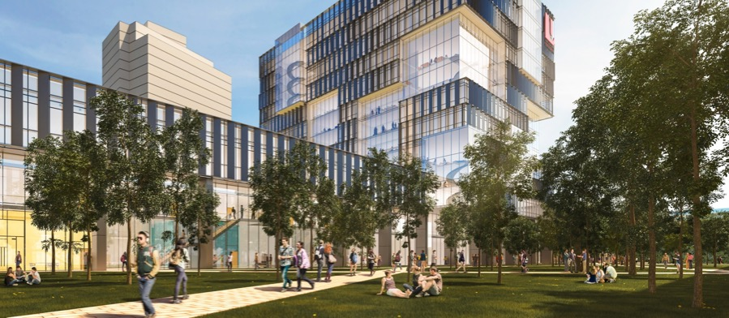
MARKHAM CAMPUS

Slide 16
Capital Projects
    Under Construction
      CUB Renewal and Upgrades, SIF, 04/2018
      Schulich School of Business Expansion, SIF, 04/2018
      Health & Science Refresh, SIF, 04/2018
        Chemistry, Dec 2017
        Farquharson, April 2018
        Lumbers, Dec 2017
        Petrie Science, Dec 2017
        Glendon Biology Labs, Sept 2017
      New Student Centre, 04/2018
Notes:
16

Slide 17
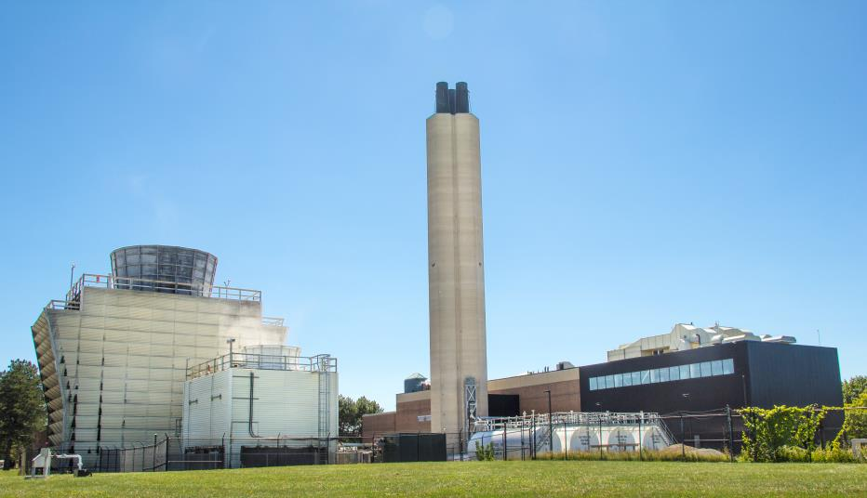
CUB Renewal and Upgrades
Project Managed by CSBO Energy Management, Brad Cochrane, Director
Notes:
17

Slide 18
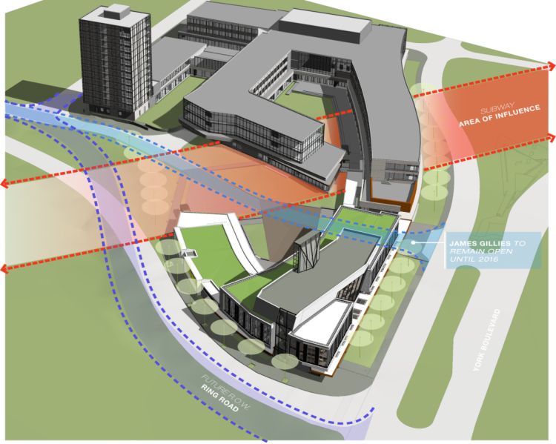
Schulich School of Business - Expansion
Baird Sampson Neuart Architects
Project Managed by CSBO Facilities Development Irina Arsene, Project Manager
Notes:
18

Slide 19
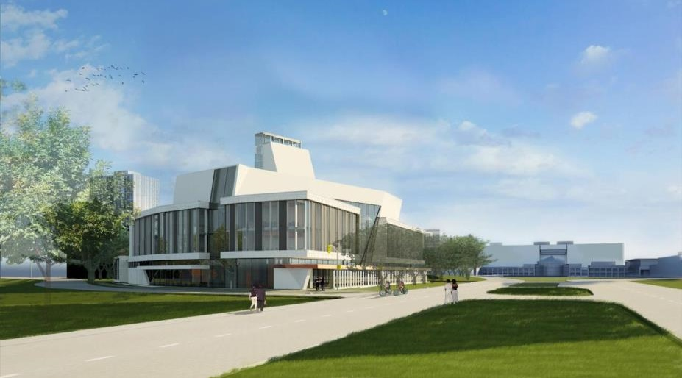
Schulich School of Business - Expansion
Baird Sampson Neuart Architects
Notes:
19

Slide 20
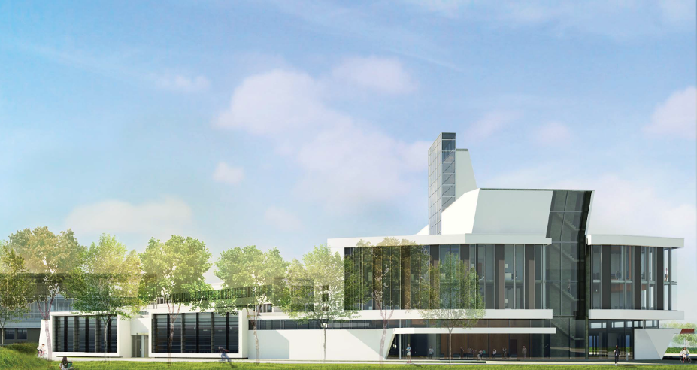
Schulich School of Business - Expansion
Baird Sampson Neuart Architects
Notes:
20

Slide 21
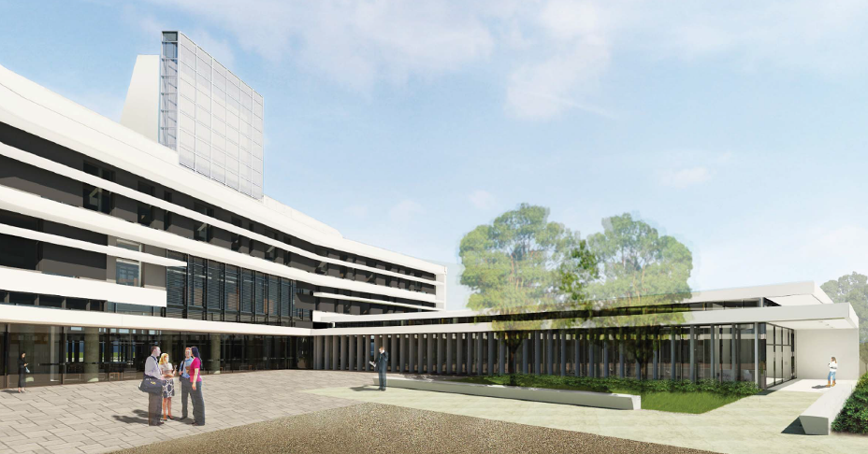
Schulich School of Business - Expansion
Baird Sampson Neuart Architects
Notes:
21

Slide 22
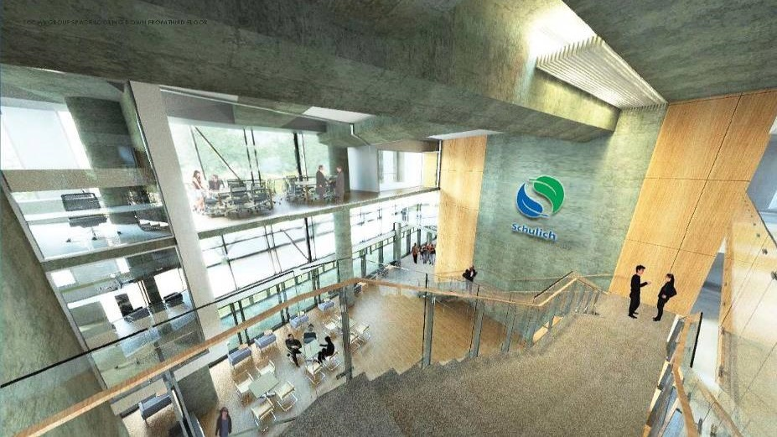
Schulich School of Business - Expansion
Baird Sampson Neuart Architects
Notes:
22

Slide 23

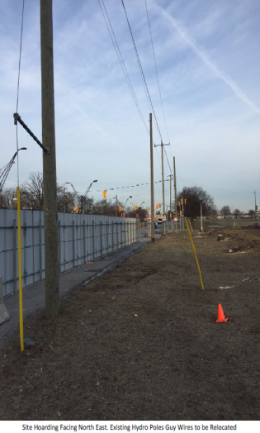
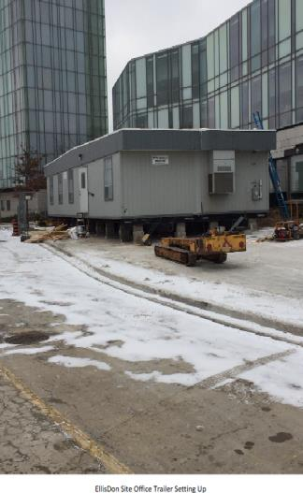
Schulich School of Business - Expansion
General Contractor Elis Don
Project Managed by CSBO Facilities Development Irina Arsene, Project Manager
Notes:
23

Slide 24
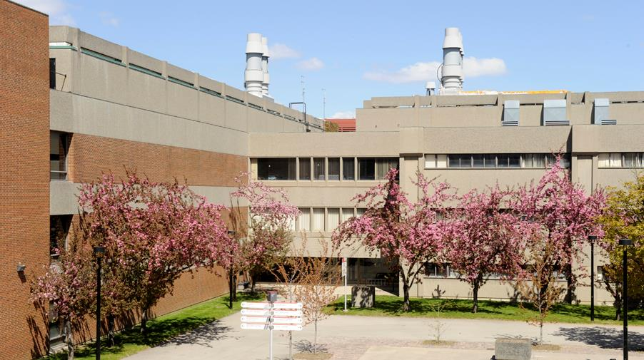
Health & Science Refresh - Farquharson
Project Managed by CSBO Facilities Planning and Renovations
Adriano Morassutti , Project Manager; Ron Ogata, Project Director

Slide 25
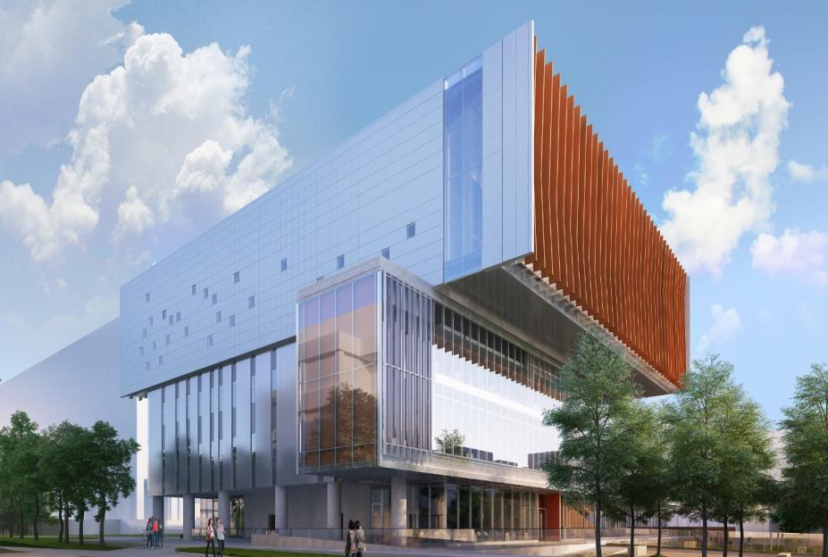
New Student Centre
Cannon Design Architects
Notes:
25

Slide 26
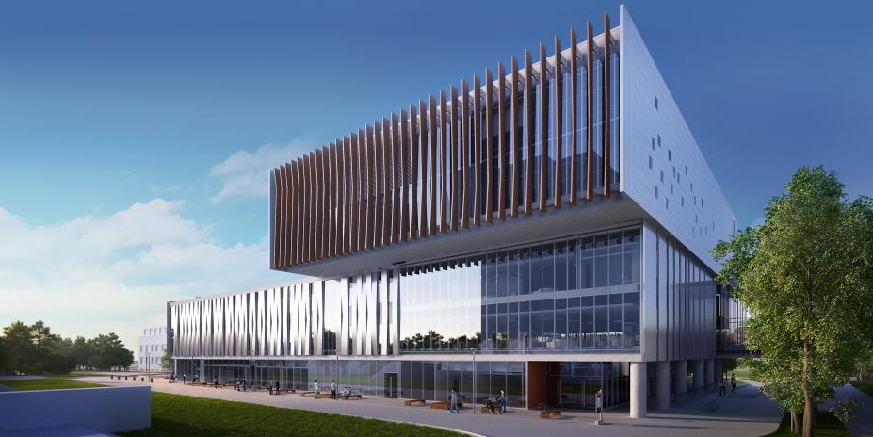
New Student Centre
Cannon Design Architects
Notes:
26

Slide 27
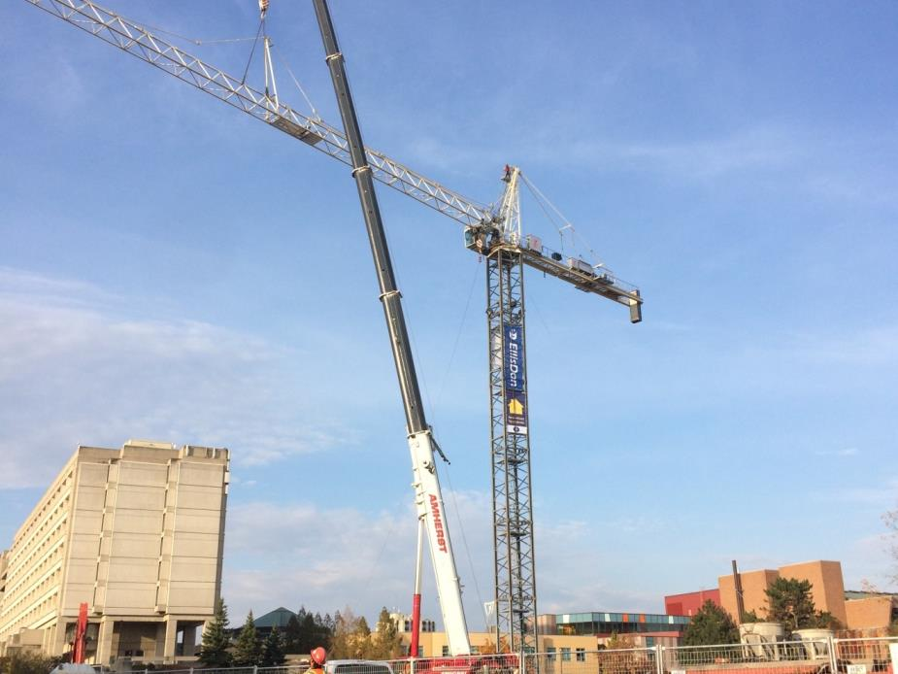
Crane Installation November 1, 2016
New Student Centre
General Contractor Elis Don
Project Managed by CSBO Facilities Development Stephen Wong, Project Manager
November 1, 2016

Slide 28
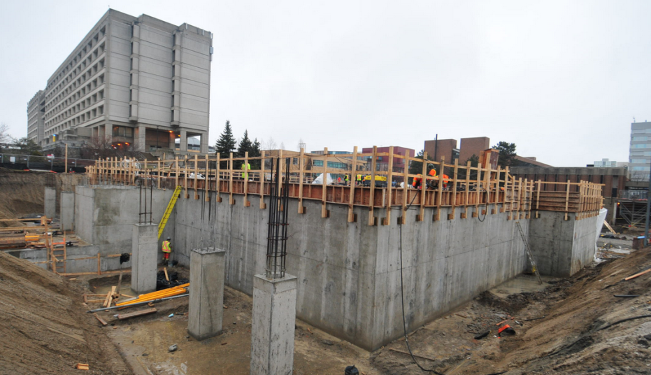
Crane Installation
New Student Centre
January 19, 2017

Slide 29
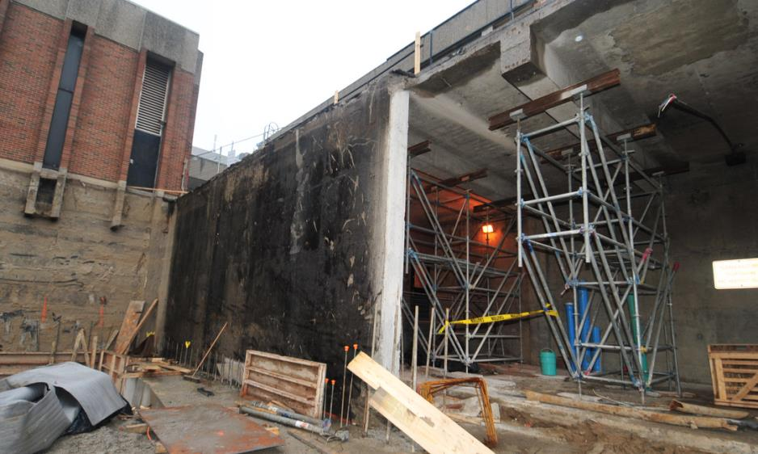
Loading Dock Preparations
New Student Centre
January 19, 2017

Slide 30
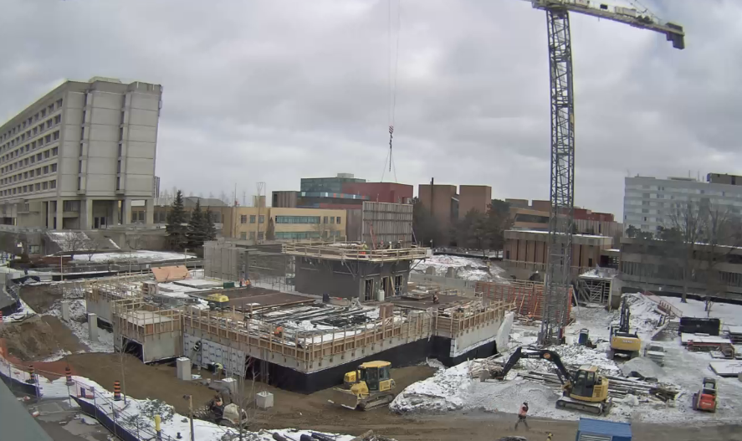
WebCam
New Student Centre
February 2, 2017

Slide 31


Toronto York-Spadina Subway Extension
Impact on York University
Senior Administrators Group Exchange
February 10, 2017

Slide 32
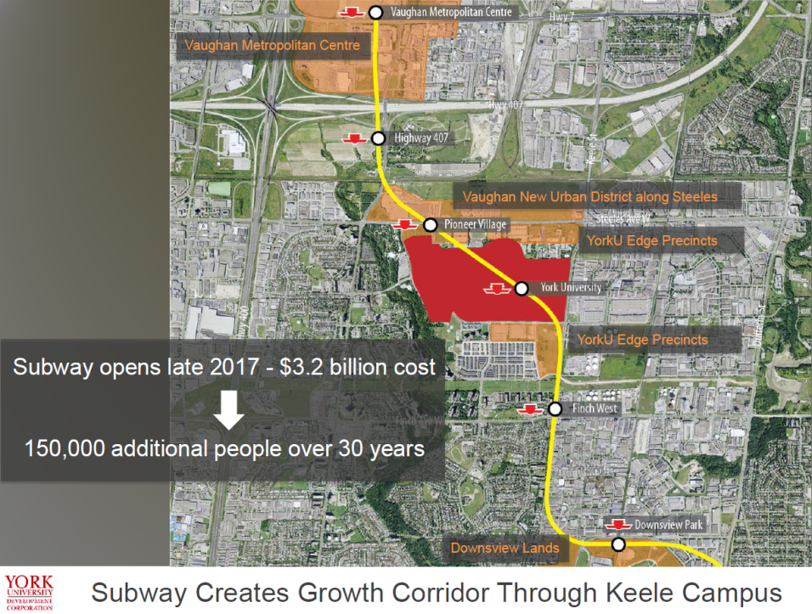

Slide 33
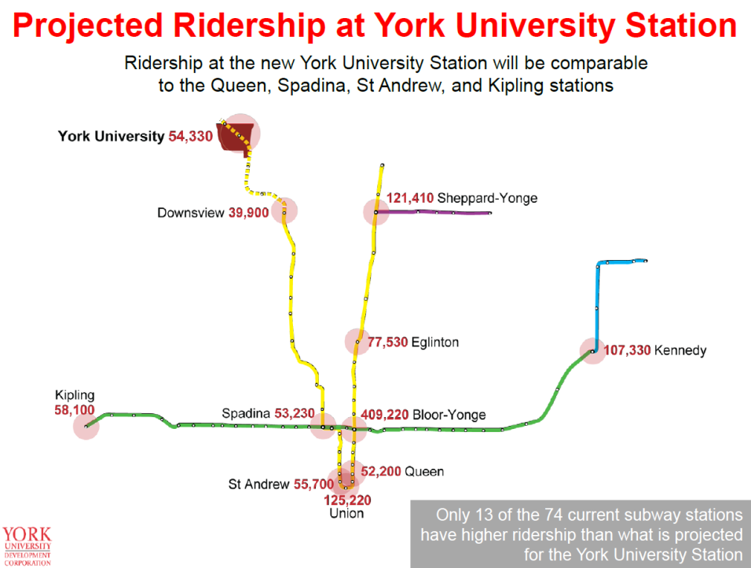

Slide 34
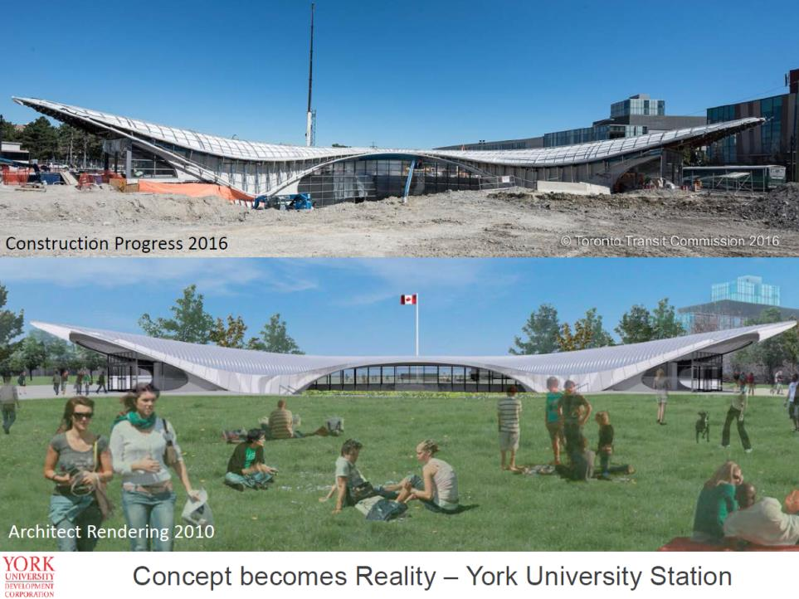

Slide 35
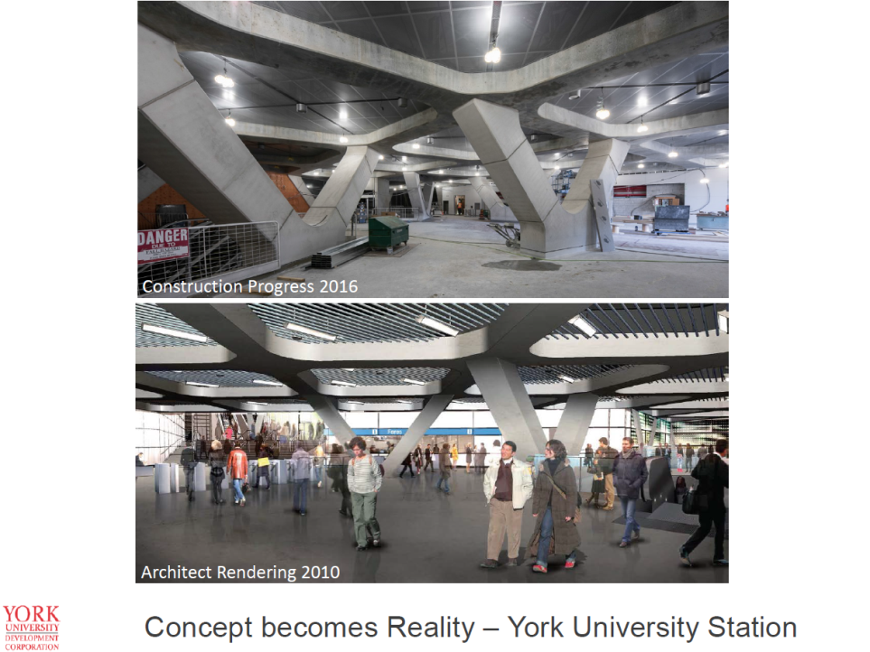

Slide 36
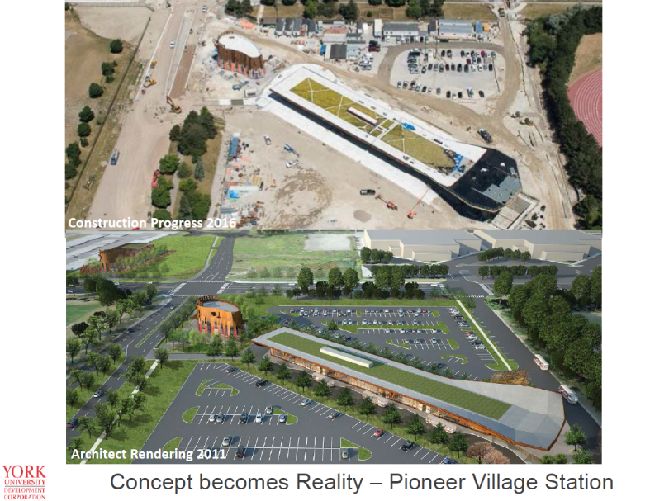

Slide 37


Slide 38
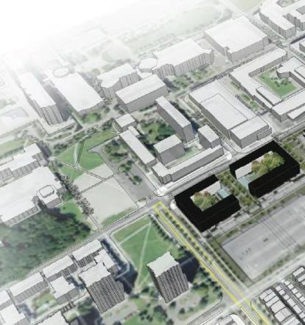
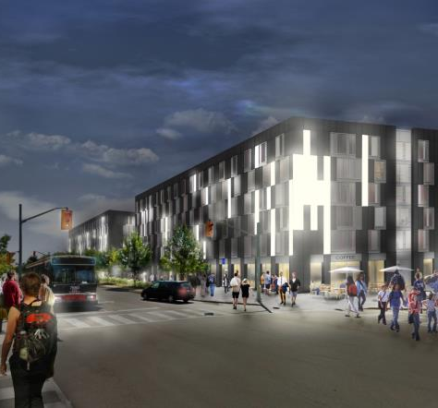
The Quad Student Housing Community
The Quad includes two buildings, located on the south side of the Pond Road, east of Sentinel Road. The project includes 812 beds of new student housing, available exclusively to York University and Seneca @ York students. The project also includes ground floor retail along the Pond Road.

Slide 39
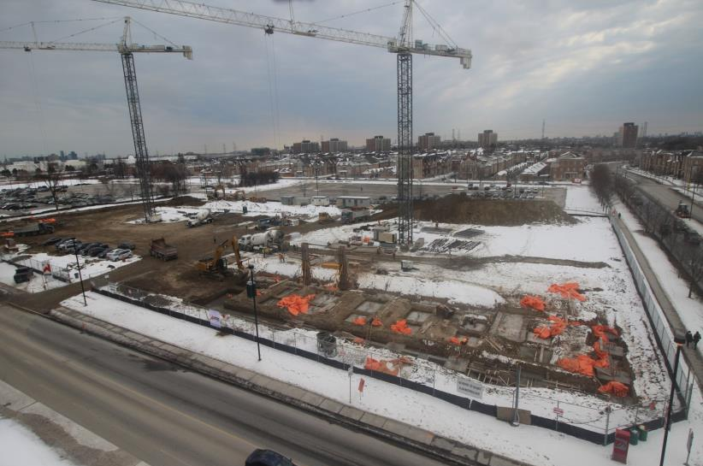
The Quad: February 19, 2016

Slide 40
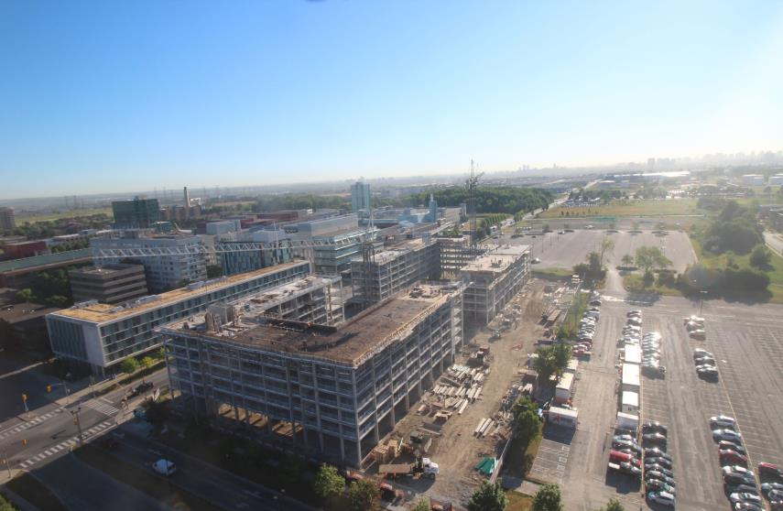
The Quad: June 30, 2016

Slide 41
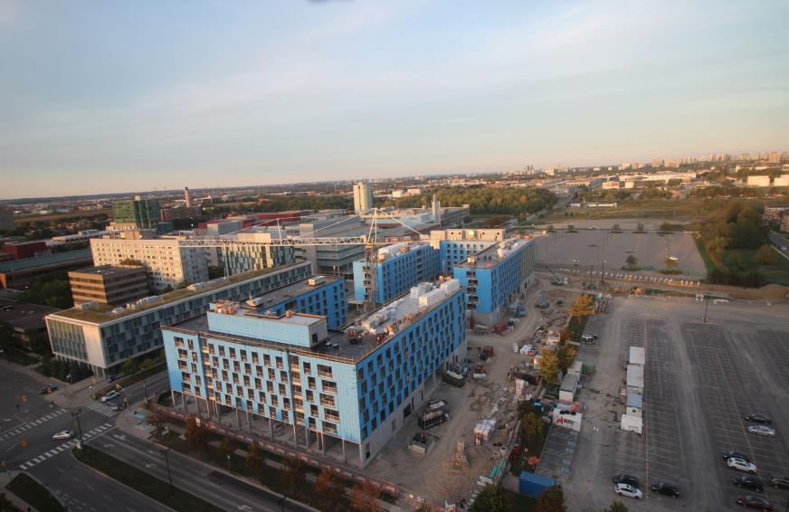
The Quad: September 25, 2016

Slide 42
Future Capital Projects
    Under Planning
      CFREF / Neuroscience Facility, 05/2020
        Approx 2,785 m2 (30,000 sf), $ 28M
      School of Continuing Studies, 05/2020
        Approx 7,430 m2 (80,000 sf), $ 35M
Notes:
42

Slide 43
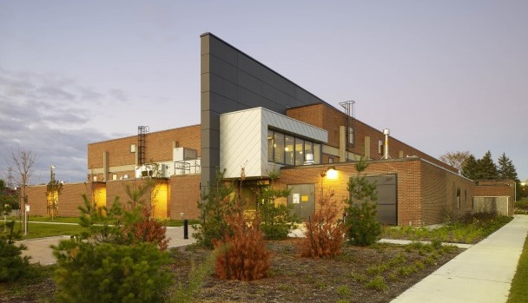
CFREF / Neuroscience Facility
NXL Architects

Slide 44
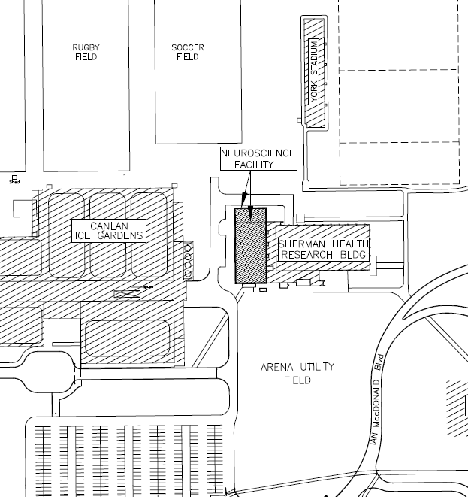
CFREF / Neuroscience Facility
Part of Canada First Research Excellence Fund (CFREF):
York’s VISTA program will contribute to the next generation of industry-ready highly qualified personnel for Canada, supporting 226 additional graduate students and post-doctoral fellows.
VISTA will include more than 50 partner organizations, 30 Canada Research Chairs and equivalents, eleven additional core faculty members, and 48 associated faculty members.
York’s $33.3 million grant will support the Vision: Science to Applications (VISTA) program. The investment supports research across a wide range of applications of vision science, from basic visual function, to computer vision and object recognition, and more.

Slide 45
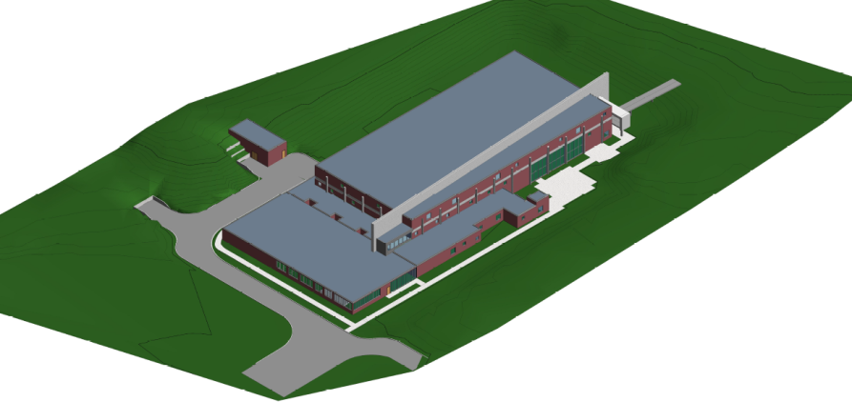
CFREF / Neuroscience Facility
Concept by CSBO Planning and Architecture Design, Irma Kabashi, Planner

Slide 46
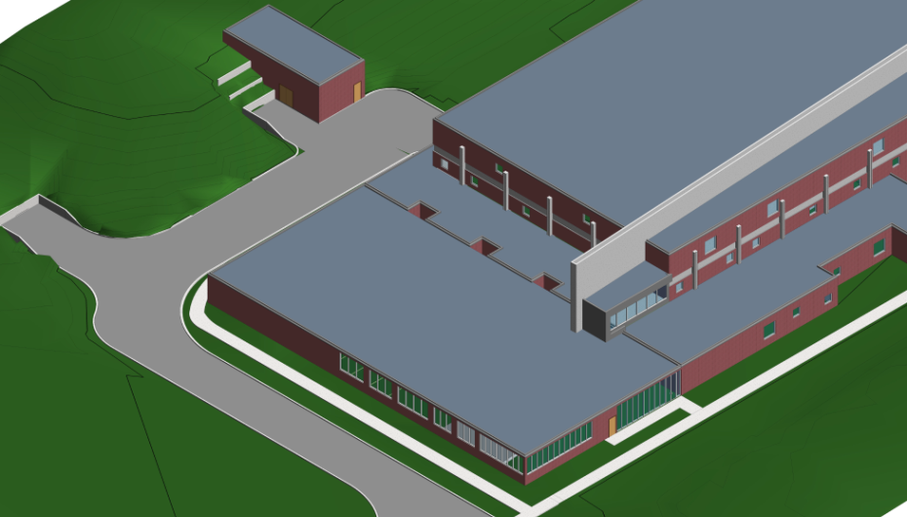
CFREF / Neuroscience Facility
Concept by CSBO Planning and Architecture Design, Irma Kabashi, Planner

Slide 47
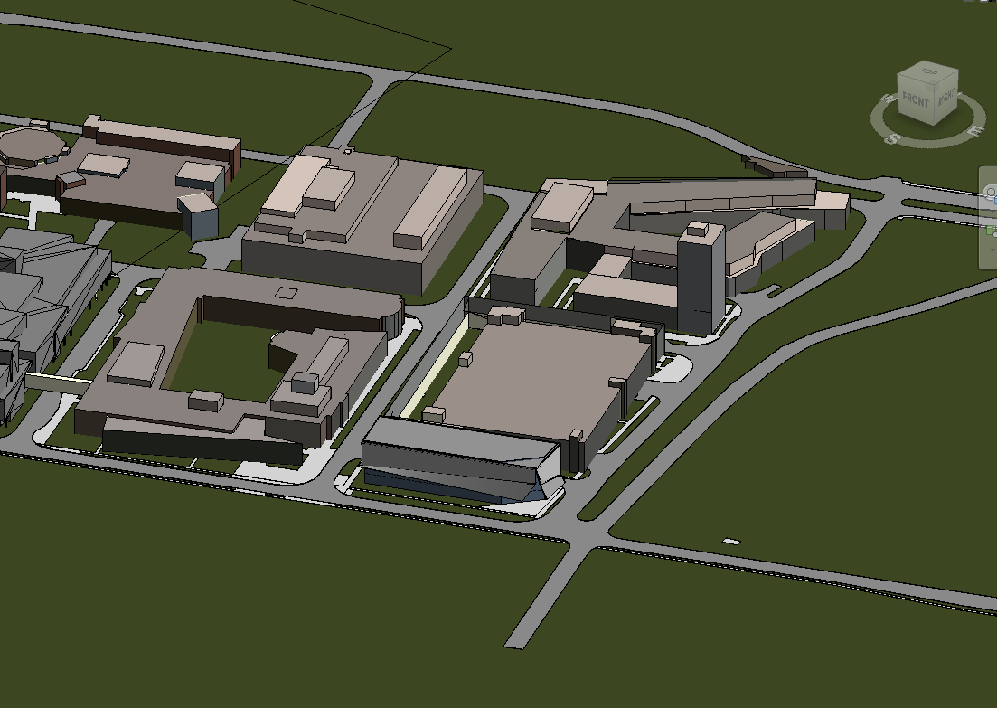
School of Continuing Studies
    Program
      Classrooms: 3 @ 60 person, 1 @ 100 person
      Seminar rooms: 23 @ 25 person
      Meeting rooms, breakout rooms, computer rooms
      Student social spaces, admin offices, lounges

Slide 48
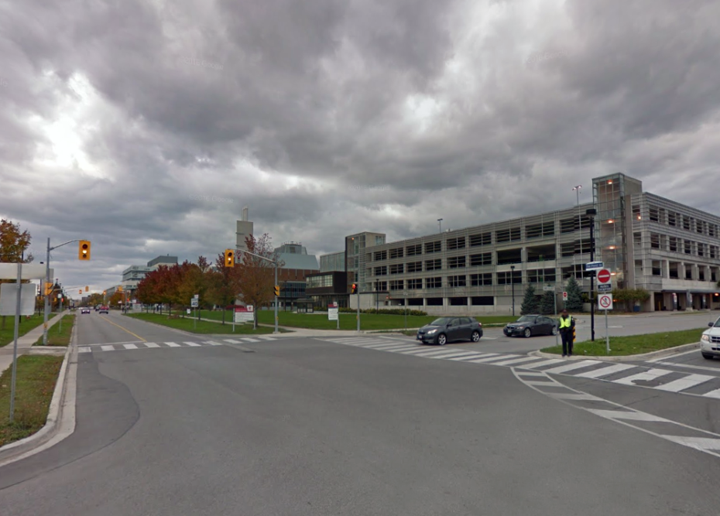
School of Continuing Studies

Slide 49
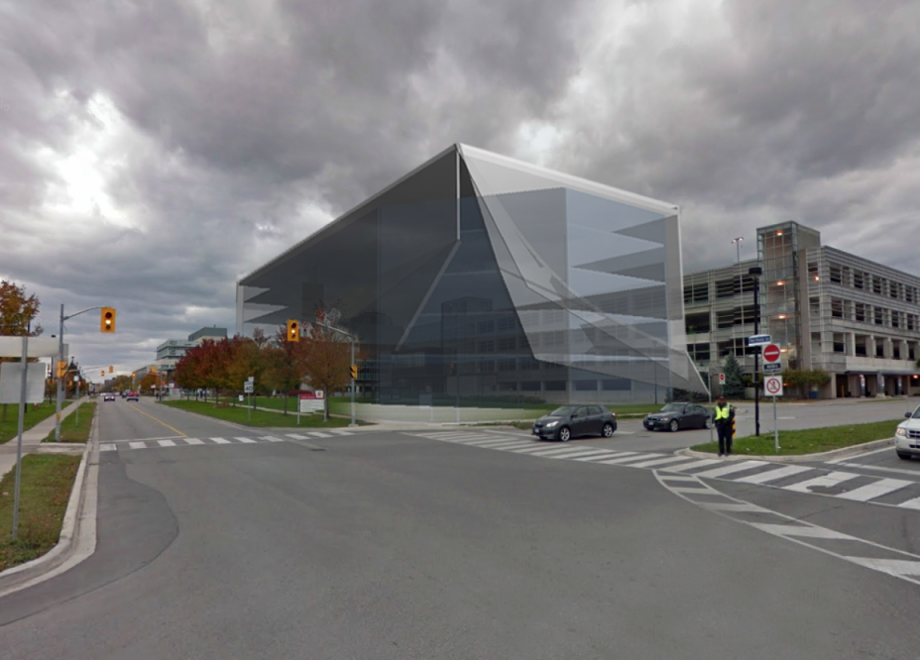
School of Continuing Studies
Concept by CSBO Planning and Architecture Design, Patrick Saavedra, Director

Slide 50
Major Renovations
      Central Square Podium Renewal, 08/2017
      Dahdaleh Institute for Global Health, 12/2017
      ADERSIM Lab / EOC, 05/2018
      Tatham Renewal, 08/2017
Notes:
50

Slide 51
Central Square Podium
2015 - 2017
Central Square Podium Renewal
2012-16
$ 6,400,000
GFA 10,600 m2 (114,000 sf)
Program:
  Water proofing
  Multi-phased
  Green roof
  Seating
  Lighting
  Planting / bio-diversity
  Improved aesthetics
Project Managed by CSBO Facilities Planning and Renovations
Sean Thibeault, Project Coordinator

Slide 52
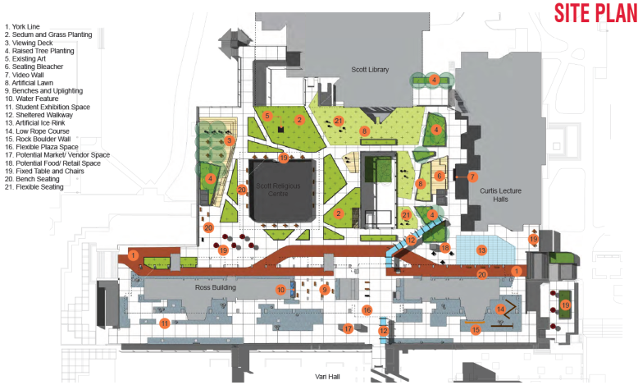
Central Square Podium Renewal
Scott Torrance Landscape Architects

Slide 53
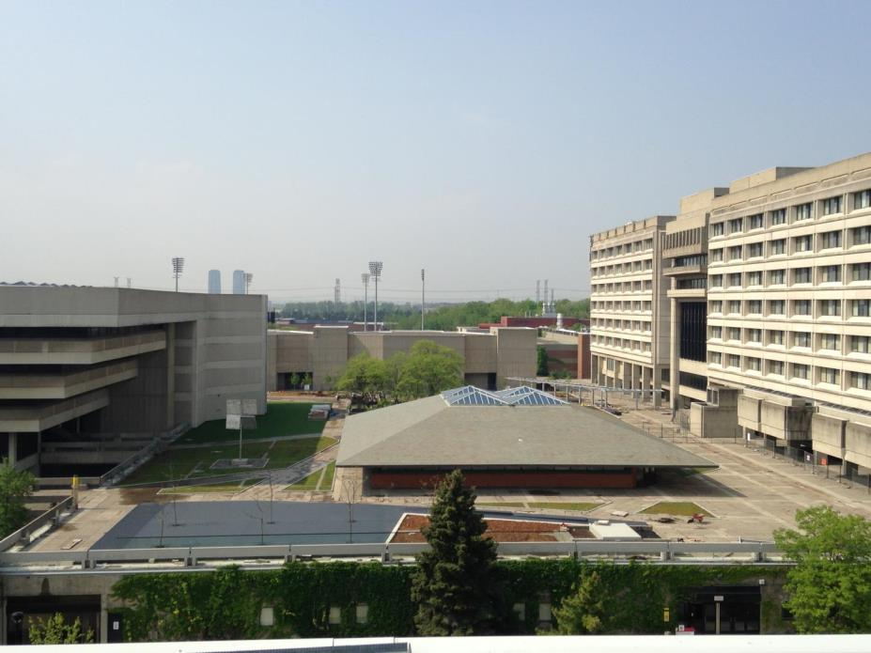
Central Square Podium Renewal
Scott Torrance Landscape Architects

Slide 54
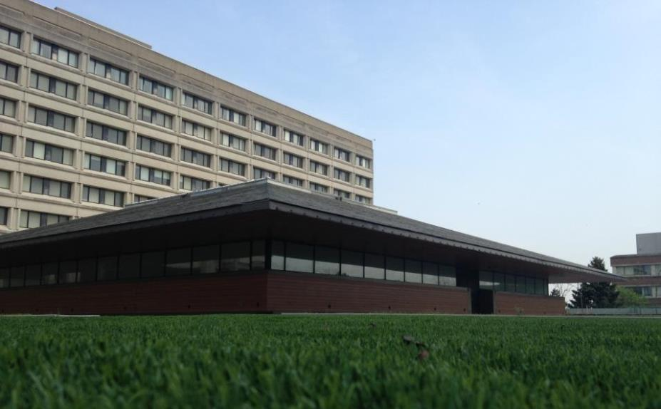
Central Square Podium Renewal
Scott Torrance Landscape Architects

Slide 55
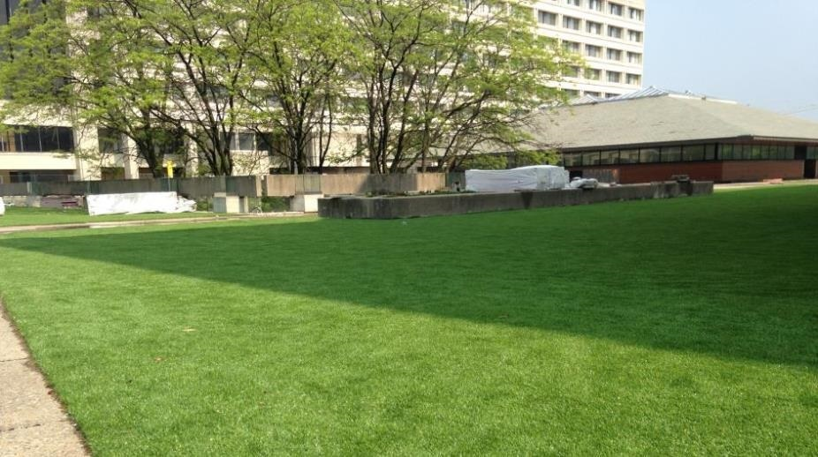
Central Square Podium Roof
Scott Torrance Landscape Architects

Slide 56
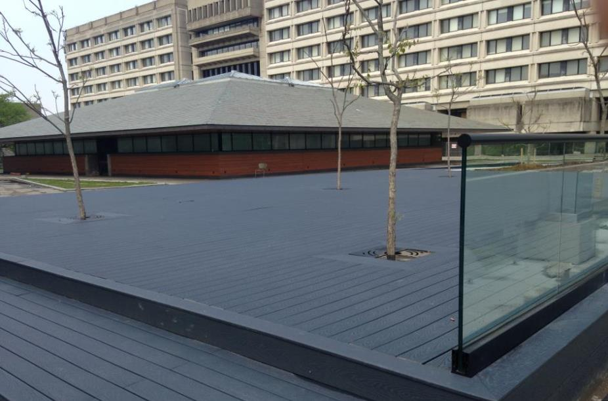
Central Square Podium Roof
Scott Torrance Landscape Architects

Slide 57
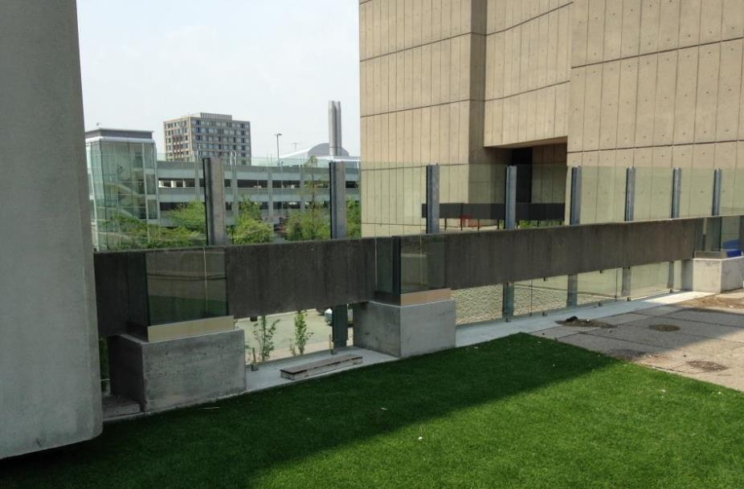
Central Square Podium Roof
Scott Torrance Landscape Architects

Slide 58
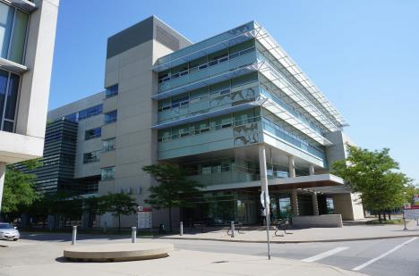
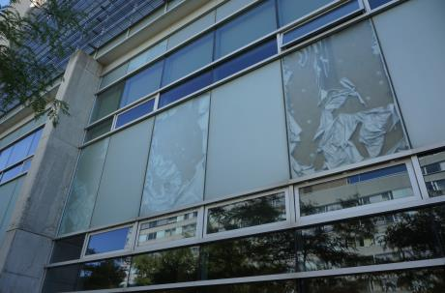
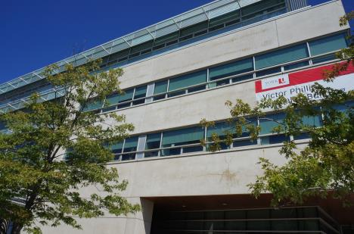

Victor Phillip Dahdaleh Building

Slide 59
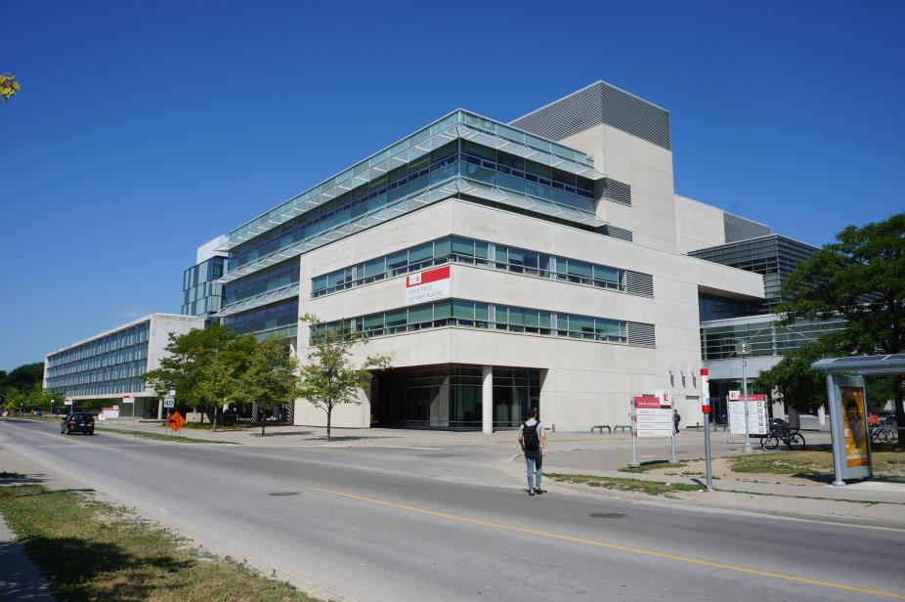
Victor Phillip Dahdaleh Building

Slide 60
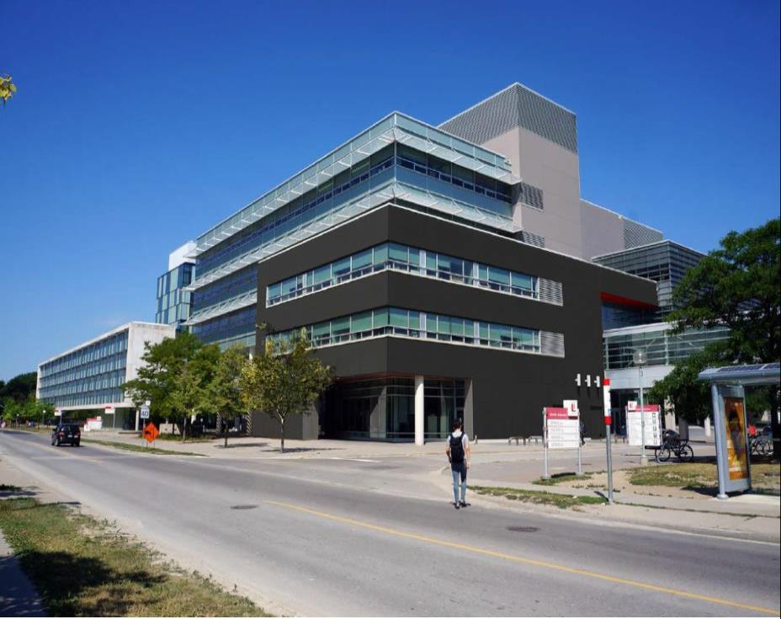
Victor Phillip Dahdaleh Building
Concept by CSBO Planning and Architecture Design

Slide 61
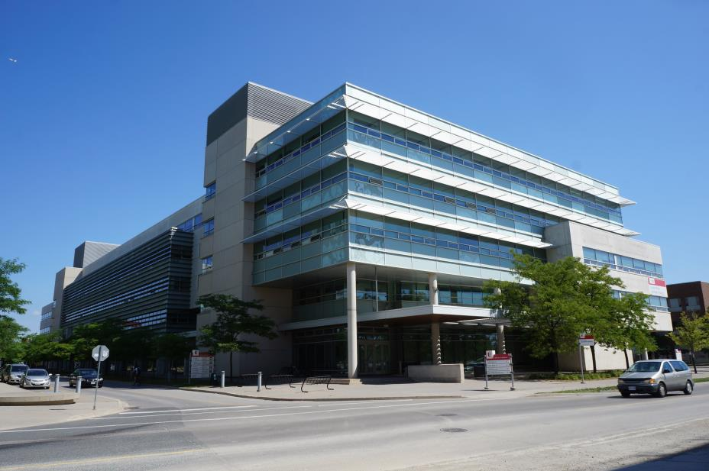
Victor Phillip Dahdaleh Building

Slide 62
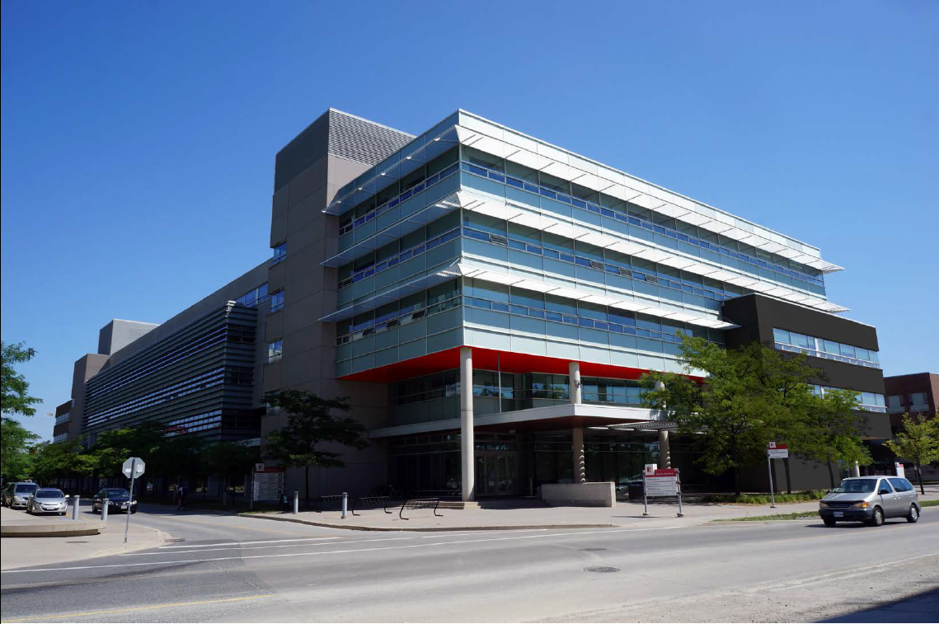
Victor Phillip Dahdaleh Building
Concept by CSBO Planning and Architecture Design

Slide 63
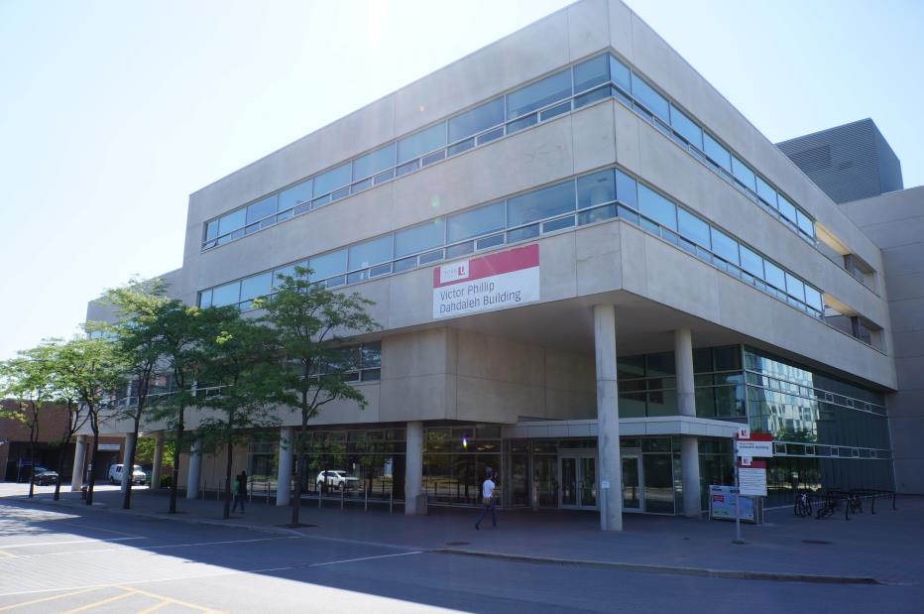
Victor Phillip Dahdaleh Building

Slide 64
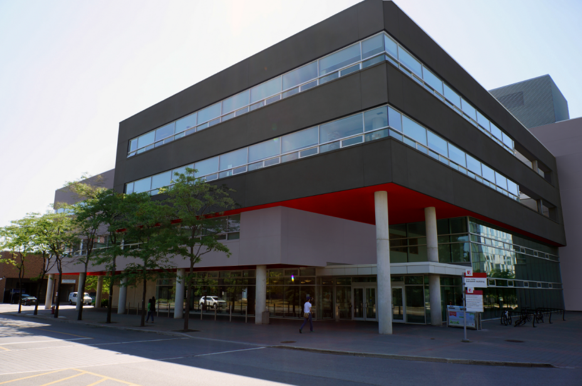
Victor Phillip Dahdaleh Building
Concept by CSBO Planning and Architecture Design

Slide 65
Outline
Budget Planning Update
Capital Planning Updates
    Under construction
    Major renovations
    Future capital projects
Cap and Trade Report
Community Safety
  Sexual Violence Policy Development Update
Questions and Answers

Slide 66
Cap and Trade
How Cap and Trade Works

Slide 67
Carbon Pricing Regulatory Update
Ministry of the Environment and Climate Change Greenhouse Gas regulations were announced by the Premier of Ontario on April 13, 2015
New provincial regulations promulgated on May 18 and 19, 2016 - Cap and Trade auction based regime linked with Quebec and California, not a flat tax like B.C.
First regulatory period is 2017-2020 with Nov. 2021 "true up". Provincial carbon reduction targets are expected to be in the 3-5% per year range through 2020.

Slide 68
Carbon Pricing Regulatory Update
The Keele campus is eligible for free allowances during the first regulatory period, but not Glendon.
York University registered as a mandatory participant in the Cap and Trade program in 2016.
The 2017 free allowances (52,857) have been granted.
North American carbon pricing may be dominated by the $US, carbon taxes may therefore come under unanticipated exchange rate pressures

Slide 69
Carbon Pricing Regulatory Update
The Province released its first Five (5) Year Climate Change Action Plan in April 2016, program details have not been released.
CSBO and faculty staff will leverage PSE SIF projects to further improve energy performance.
Recent work is focused on investigating alternative low carbon technologies (electric vehicles, biogas, heat pumps/geothermal, ambient geo exchange study with NRCAN) to meet future climate change mitigation goals and regulations.

Slide 70
Carbon Pricing Regulatory Update
Federal government announced Dec'16 national floor price of $10/tonne starting in 2018, increasing by $10/tonne/year to $50/tonne by 2022.
How will York Keele campus be treated beyond 2020???
Could be $2,750,000 annual "challenge"

Slide 71
The Final Word
We all have a responsibility to reduce reliance on fossil fuels.
At York, 60% of our fossil fuel (natural gas) consumption is for thermal energy (to heat and cool our buildings).
It is ecologically, and now financially, important that York U prepare a plan with 10, 20, and 30 year milestones to reduce fossil fuel use.
In plain English, that means dramatically improving buildings’ thermal performance, reducing electrical use, and introducing alternative sources of energy.

Slide 72
Outline
Budget Planning Update
Capital Planning Updates
    Under construction
    Major renovations
    Future capital projects
Cap and Trade Report
Community Safety
  Sexual Violence Policy Development Update
Questions and Answers

Slide 73
Background
Bill 132 and the Premier’s Action Plan to Stop Sexual Violence and Harassment.
York’s Sexual Violence Policy Working Group established in 2013.
Extensive consultation process with community.
  Over 35 Groups
  3 Open Forums
  Anonymous submissions
Sexual Violence Policy approved by Board Of Governors
  December 14, 2016
Notes:
Bill 132 amended various statutes with respect to sexual violence, sexual harassment, domestic violence and related matters.
The development of the Sexual Violence Policy was a result of a process of collaboration and community consultation.
The Policy was the outcome of the extensive and ongoing dedication of the Sexual Violence Policy Working Group.
We also did a wide consultation process with the community.
Met with over 600 community members.
Policy Approval was a significant milestone for our community.
We will continue to improve processes and services based on community input.

Slide 74
Purpose and Scope
The Policy affirms York’s ongoing commitment to foster a culture that:
  Supports Survivors
  Holds accountable those who commit sexual violence
  Rejects attitudes and behaviours that perpetuate sexual violence.
The Policy applies to all York University community members. Regardless of where or when the incident(s) occurs.
Notes:
The Sexual Violence Policy replaces the Policy on Sexual Assault Awareness, Prevention, and Response Policy and the Policy on Sexual Harassment.
- Sexual Violence is a broad term reflecting a continuum of violence.
- The Policy has a broad scope.
- Applies to students, staff, administrators, faculty, librarians, members of the Board of Governors and Senate, adjunct and visiting faculty, postdoctoral fellows, volunteers, contractors, and invited guests.
- It is also important to note that the Policy does not replace collective agreement provisions, nor does it limit access to external legal proceedings.

Slide 75
Principles & Commitments
Anyone can experience sexual violence.
Policy identifies the wider systemic issues that contribute to sexual violence.
Survivors can experience many barriers to disclosing, reporting, and/or seeking support; barriers can differ based on the lived experience of the survivor.
York strives to reduce these barriers in order to better support survivors in the community.
Notes:
- The Policy recognizes the complexity of experiences of sexual violence and that sexual violence can be motivated by sexism, racism, colonialism, ableism, homophobia and/or transphobia.
- This can be part of a wider societal context that includes patriarchy, whiteness, and colonization as contributors to acts of sexual violence.
- Part of our ongoing commitment is to strive to reduce these barriers within our own community.
- Examples of reducing barriers are:
Streaming processes (Having a designated office)
Communicating broadly about the policy and processes
Changing the practice around automatic reporting to police services.
Developing training for the community that takes a more in-depth look at the barriers
Providing culturally and community specific referrals
And having a policy in place that applies to all community members.

Slide 76
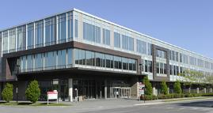

Sexual Violence Response Office
Established as the first point of contact for all community members.
Assists with the coordination of:
  Referrals
  Accommodations
  Connecting with Counselling
  Safety Planning
  Housing Relocation
  Information about Criminal and Non-Criminal Reporting Options
  Navigating University Processes and Legal Systems.
* A formal complaint is not required in order to access supports and accommodations.
Notes:
- The Sexual Violence Response Office is a resource for all community members, including students, staff, and faculty.
- You can contact them 24/7 by phone.

Slide 77
Complaint Process
Complaints Against Students
  An Investigative model is utilized to adjudicate incidents.
  University Tribunal handles Appeals.
Complaints Against Respondents Who are Both Students and Staff or Faculty
  A determination will be made to process the complaint either through the student or the staff/faculty complaint procedures.
Complaints Against Staff or Faculty
  The Office will ensure that the complaint proceeds under applicable collective agreements and policies.
Notes:
- The complaint process is based on the affiliation of the respondent.
- The Policy created more alignment of the Student process with Staff/Faculty Process.

Slide 78
Education and Training
Education and Training will aim to build understanding of the Policy as well as:
  Promote a change in the attitudes and behaviours that perpetuate sexual violence
  Create a more supportive environment for survivors
  Take an intersectional and anti-oppression approach to addressing the issue of sexual violence
Notes:
- Programming will aim to address systemic issues contributing to sexual violence and aim to challenge rape culture and other forms of discrimination and hate.

Slide 79
Sexual Violence Policy Implementation
Policy Approved By Board Of Governors
Key Commitments and Next Steps
Follow-up with Consultation Participants
Stand-Alone Sexual Violence Office
Roll-out of Training to Community

Slide 80
Outline
Budget Planning Update
Capital Planning Updates
    Under construction
    Major renovations
    Future capital projects
Cap and Trade Report
Community Safety
  Sexual Violence Policy Development Update
Questions and Answers

